Slide 1
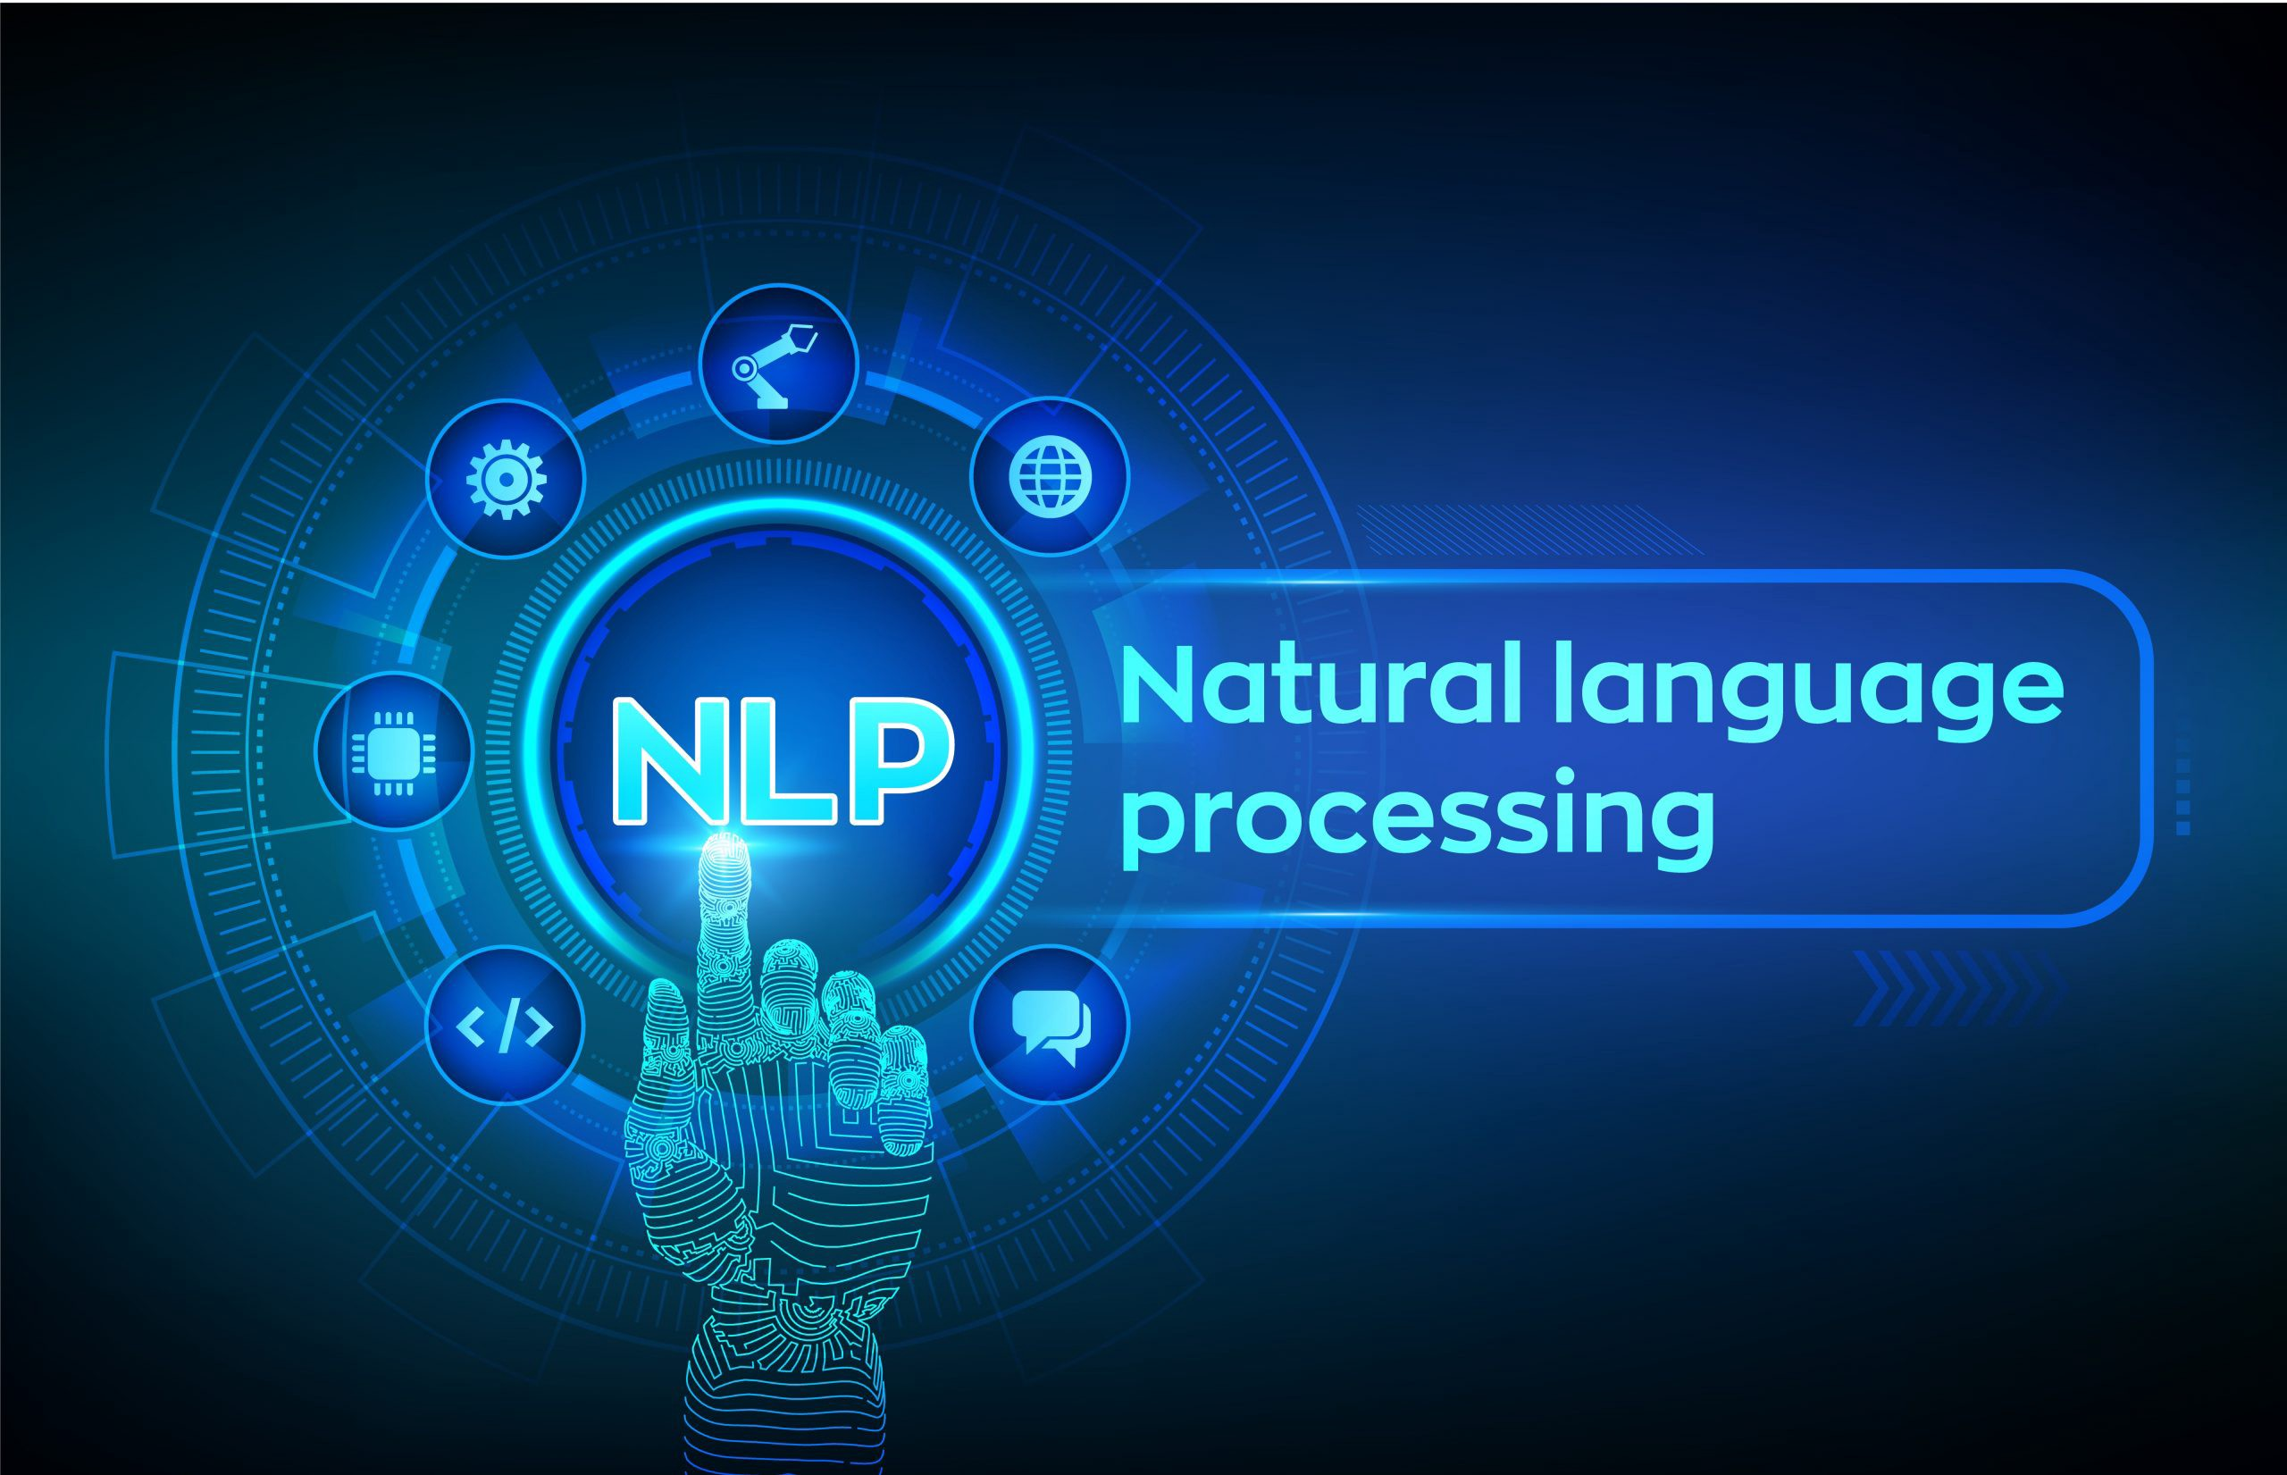
The lecture 9
Text classification

Slide 2
Text classification
Text classification is also often called text categorization.
Text categorization can be done in many ways, as mentioned.
We will be focusing explicitly on a supervised approach using classification.
The process of classification is not restricted to text alone. It is used quite frequently in other domains including science, healthcare, weather forecasting, and technology.
Text or document classification is the process of assigning text documents into one or more classes or categories, assuming that we have a predefined set of classes.
Documents here are textual documents, and each document can contain a sentence or even a paragraph of words.
A text classification system would successfully be able to classify each document to its correct class(es) based on inherent properties of the document.

Slide 3

Text classification
Mathematically, we can define it like this: given some description and attributes d for a document D, where $dεD$, and we have a set of predefined classes or categories, $C=\{c_{1},c_{2},…,c_{n}\}$

Slide 4
Text classification
There are various types of text classification:
Content-based classification
Request-based classification
Both types are more like different philosophies or ideals behind approaches to classifying text documents rather than specific technical algorithms or processes.
Content-based classification is the type of text classification where priorities or weights are given to specific subjects or topics in the text content that would help determine the class of the document. A conceptual example would be that a book with more than 30 percent of its content about food preparations can be classified under cooking/recipes.
Request-based classification is influenced by user requests and is targeted towards specific user groups and audiences.

Slide 5
Automated Text Classification
We now have an idea of the definition and scope of text classification.
We have also formally defined text classification both conceptually and mathematically, where we talked about a “text classification system” being able to classify text documents to their respective categories or classes.
Consider several humans doing the task of going through each document and classifying it. They would then be a part of the text classification system we are talking about. However, that would not scale very well once there were millions of text documents to be classified quickly.
To make the process more efficient and faster, we can consider automating the task of text classification, which brings us to automated text classification.

Slide 6
ML techniques
To automate text classification, we can make use of several ML techniques and concepts.
There are mainly two types of ML techniques that are relevant to solving this problem:
Supervised machine learning
Unsupervised machine learning
Unsupervised learning refers to specific ML techniques or algorithms that do not require any pre-labelled training data samples to build a model. We usually have a
collection of data points, which could be text or numeric, depending on the problem we are trying to solve. We extract features from each of the data points using a process known as feature extraction and then feed the feature set for each data point into our algorithm.
We are trying to extract meaningful patterns from the data, such as trying to group together similar data points using techniques like clustering or summarizing documents based on topic models. This is extremely useful in text document categorization and is also called document clustering, where we cluster documents into groups purely based on their features, similarity, and attributes, without training any model on previously labelled data.

Slide 7
ML techniques
Supervised learning refers to specific ML techniques or algorithms that are trained on pre-labelled data samples known as training data.
Features or attributes are extracted from this data using feature extraction, and for each data point we will have its own feature set and corresponding class/label.
The algorithm learns various patterns for each type of class from the training data. Once this process is complete, we have a trained model.
This model can then be used to predict the class for future test data samples once we feed their features to the model. Thus the machine has actually learned, based on previous training data samples, how to predict the class for new unseen data samples.

Slide 8
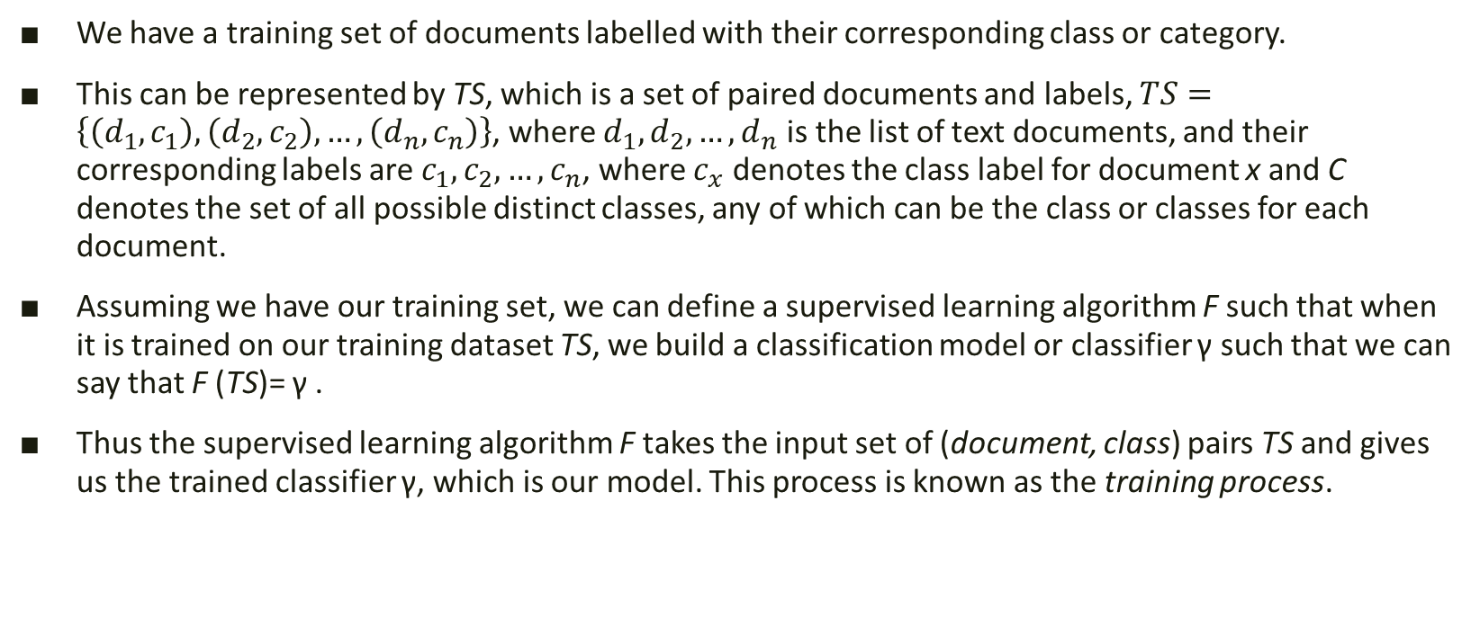
ML text classification
We have a training set of documents labelled with their corresponding class or category.
This can be represented by TS, which is a set of paired documents and labels, $TS=\left\{\left(d_{1},c_{1}\right),\left(d_{2},c_{2}\right),…,\left(d_{n},c_{n}\right)\right\}$, where $d_{1},d_{2},…,d_{n}$ is the list of text documents, and their corresponding labels are $c_{1},c_{2},…,c_{n}$, where $c_{x}$ denotes the class label for document x and C denotes the set of all possible distinct classes, any of which can be the class or classes for each document.
Assuming we have our training set, we can define a supervised learning algorithm F such that when it is trained on our training dataset TS, we build a classification model or classifier γ such that we can say that F (TS)= γ .
Thus the supervised learning algorithm F takes the input set of (document, class) pairs TS and gives us the trained classifier γ, which is our model. This process is known as the training process.

Slide 9
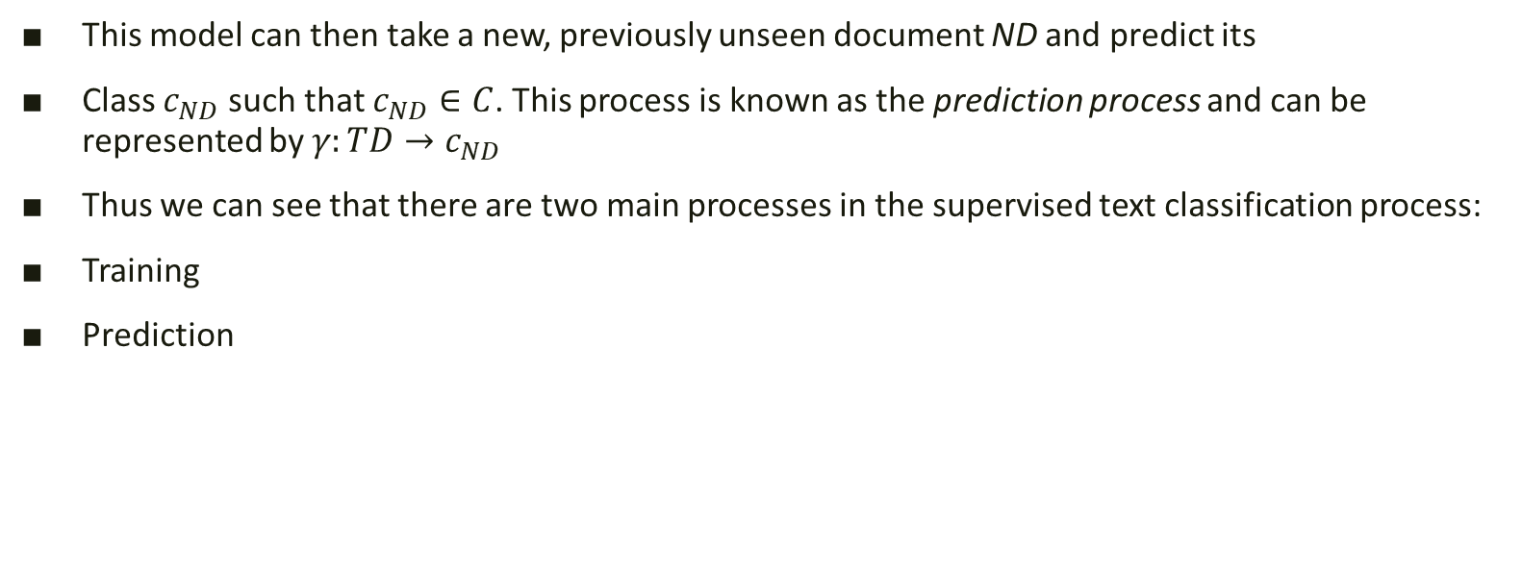
ML text classification
This model can then take a new, previously unseen document ND and predict its
Class $c_{ND}$ such that $c_{ND}∈C$. This process is known as the prediction process and can be represented by $γ:TD→c_{ND}$
Thus we can see that there are two main processes in the supervised text classification process:
Training
Prediction

Slide 10
ML text classification
There are a few types of text classification based on the number of classes to predict and the nature of predictions. These types of classification are based on the dataset, the number of classes/categories pertaining to that dataset, and the number of classes that can be predicted on any data point:
Binary classification is when the total number of distinct classes or categories is two in number and any prediction can contain either one of those classes.
Multi-class classification, also known as multinomial classification, refers to a problem where the total number of classes is more than two, and each prediction gives one class or category that can belong to any of those classes. This is an extension of the binary classification problem where the total number of classes is more than two.
Multi-label classification refers to problems where each prediction can yield more than one outcome/predicted class for any data point.

Slide 11
Text classification blueprint

Slide 12
Feature extraction
There are various feature-extraction techniques that can be applied on text data, but before we jump into then, let us consider what we mean by features. Why do we need them, and how they are useful?
In a dataset, there are typically many data points. Usually the rows of the dataset and the columns are various features or properties of the dataset, with specific values for each row or observation.
In ML terminology, features are unique, measurable attributes or properties for each observation or data point in a dataset.
Features are usually numeric in nature and can be absolute numeric values or categorical features that can be encoded as binary features for each category in the list using a process called one-hot encoding. The process of extracting and selecting features is both art and science, and this process is called feature extraction or feature engineering.

Slide 13
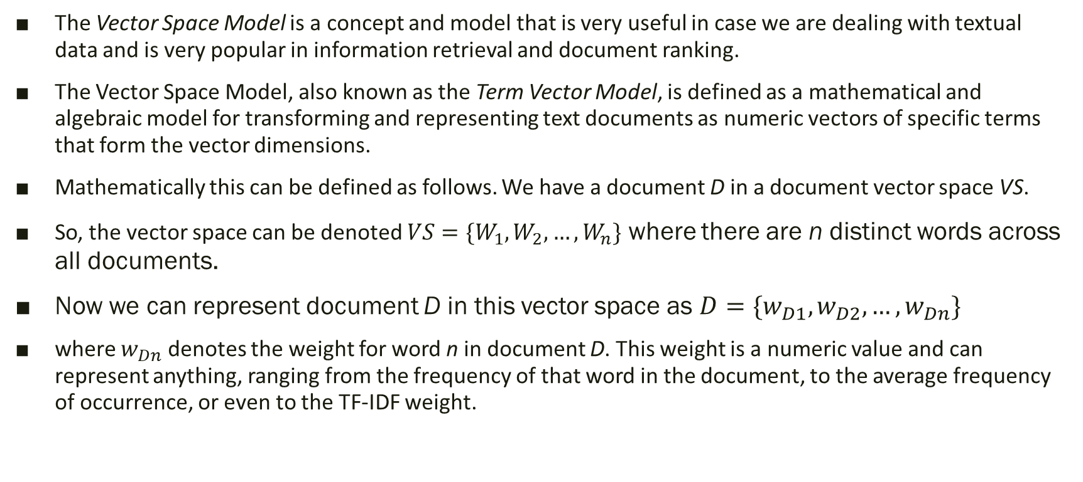
Feature extraction
The Vector Space Model is a concept and model that is very useful in case we are dealing with textual data and is very popular in information retrieval and document ranking.
The Vector Space Model, also known as the Term Vector Model, is defined as a mathematical and algebraic model for transforming and representing text documents as numeric vectors of specific terms that form the vector dimensions.
Mathematically this can be defined as follows. We have a document D in a document vector space VS.
So, the vector space can be denoted $VS=\{W_{1},W_{2},…,W_{n}\}$ where there are n distinct words across all documents.
Now we can represent document D in this vector space as $D=\{w_{D1},w_{D2},…,w_{Dn}\}$
where $w_{Dn}$ denotes the weight for word n in document D. This weight is a numeric value and can represent anything, ranging from the frequency of that word in the document, to the average frequency of occurrence, or even to the TF-IDF weight.

Slide 14
Feature extraction
We will be talking about and implementing the following feature-extraction techniques:
Bag of Words model
TF-IDF model

Slide 15
Bag of Words Model
The Bag of Words model is perhaps one of the simplest yet most powerful techniques to extract features from text documents.
The essence of this model is to convert text documents into vectors such that each document is converted into a vector that represents the frequency of all the distinct words that are present in the document vector space for that specific document.
Thus, considering our sample vector from the previous mathematical notation for D, the weight for each word is equal to its frequency of occurrence in that document.
The following code snippet gives us a function that implements a Bag of Words–based feature-extraction model that also accepts an ngram_range parameter to take into account n-grams as features
from sklearn.feature_extraction.text import CountVectorizer def bow_extractor(corpus, ngram_range=(1,1)): vectorizer = CountVectorizer(min_df=1, ngram_range=ngram_range) features = vectorizer.fit_transform(corpus) return vectorizer, features

Slide 16
Bag of Words Model
# build bow vectorizer and get features In [371]: bow_vectorizer, bow_features = bow_extractor(CORPUS) ...: features = bow_features.todense() ...: print features [[0 0 1 0 1 0 1 0 1] [1 1 1 0 2 0 2 0 0] [0 1 1 0 1 0 1 1 1] [0 0 1 1 0 1 0 0 0]] # extract features from new document using built vectorizer In [373]: new_doc_features = bow_vectorizer.transform(new_doc) ...: new_doc_features = new_doc_features.todense() ...: print new_doc_features [[0 0 1 0 0 0 1 0 0]] # print the feature names In [374]: feature_names = bow_vectorizer.get_feature_names() ...: print feature_names [u'and', u'beautiful', u'blue', u'cheese', u'is', u'love', u'sky', u'so', u'the']

Slide 17
TF-IDF Model
The Bag of Words model is good, but the vectors are completely based on absolute frequencies of word occurrences.
This has some potential problems where words that may tend to occur a lot across all documents in the corpus will have higher frequencies and will tend to overshadow other words that may not occur as frequently but may be more interesting and effective as features to identify specific categories for the documents.
This is where TF-IDF comes into the picture. TF-IDF stands for Term Frequency-Inverse Document Frequency, a combination of two metrics: term frequency and inverse document frequency.
This technique was originally developed as a metric for ranking functions for showing search engine results based on user queries and has come to be a part of information retrieval and text feature extraction now.

Slide 18
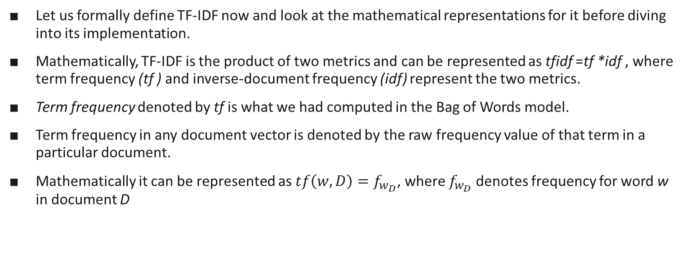
TF-IDF metric
Let us formally define TF-IDF now and look at the mathematical representations for it before diving into its implementation.
Mathematically, TF-IDF is the product of two metrics and can be represented as tfidf =tf *idf , where term frequency (tf ) and inverse-document frequency (idf) represent the two metrics.
Term frequency denoted by tf is what we had computed in the Bag of Words model.
Term frequency in any document vector is denoted by the raw frequency value of that term in a particular document.
Mathematically it can be represented as $tf\left(w,D\right)=f_{w_{D}}$, where $f_{w_{D}}$ denotes frequency for word w in document D

Slide 19
TF-IDF metric
Inverse document frequency denoted by idf is the inverse of the document frequency for each term.
It is computed by dividing the total number of documents in our corpus by the document frequency for each term and then applying logarithmic scaling on the result.
In our implementation we will be adding 1 to the document frequency for each term just to indicate that we also have one more document in our corpus that essentially has every term in the vocabulary.
This is to prevent potential division-by-zero errors and smoothen the inverse document frequencies. We also add 1 to the result of our idf computation to avoid ignoring terms completely that might have zero idf. Mathematically our implementation for idf can be represented by

Slide 20
Code snippet
The following code snippet shows an implementation of getting the tfidf-based feature vectors, considering we have our Bag of Words feature vectors we obtained in the previous section
from sklearn.feature_extraction.text import TfidfTransformer def tfidf_transformer(bow_matrix): transformer = TfidfTransformer(norm='l2’, smooth_idf=True, use_idf=True) tfidf_matrix = transformer.fit_transform(bow_matrix) return transformer, tfidf_matrix

